Slide 1
Faculty of Business Administration VŠE

Slide 2
Mission and Vision
Mission
To generate and transmit knowledge as well as to develop skills and form attitudes which are necessary for the successful management of companies and organizations in a changing world.
Vision
To be an acknowledged and referenced higher education institution in management in Europe.

Slide 3

Basic Facts
Founded 1953
Over 3500 students
9 Departments
7 Study Programmes taught in English

Slide 4
Departments
Arts management
Logistics
Management
Marketing
Managerial Economics
Human Resource Management
Entrepreneurship
Managerial Psychology and Sociology
Strategy

Slide 5
Study Programmes taught in English
Study level | Programme
Bachelor | Business Administration
Master | Management International Management/ CEMS Sustainability Management
Doctoral | Management and Managerial Economics (MMEE) Doctor of Business Administration (DBA)
MBA | Executive MBA

Slide 6







Reputation

Slide 7
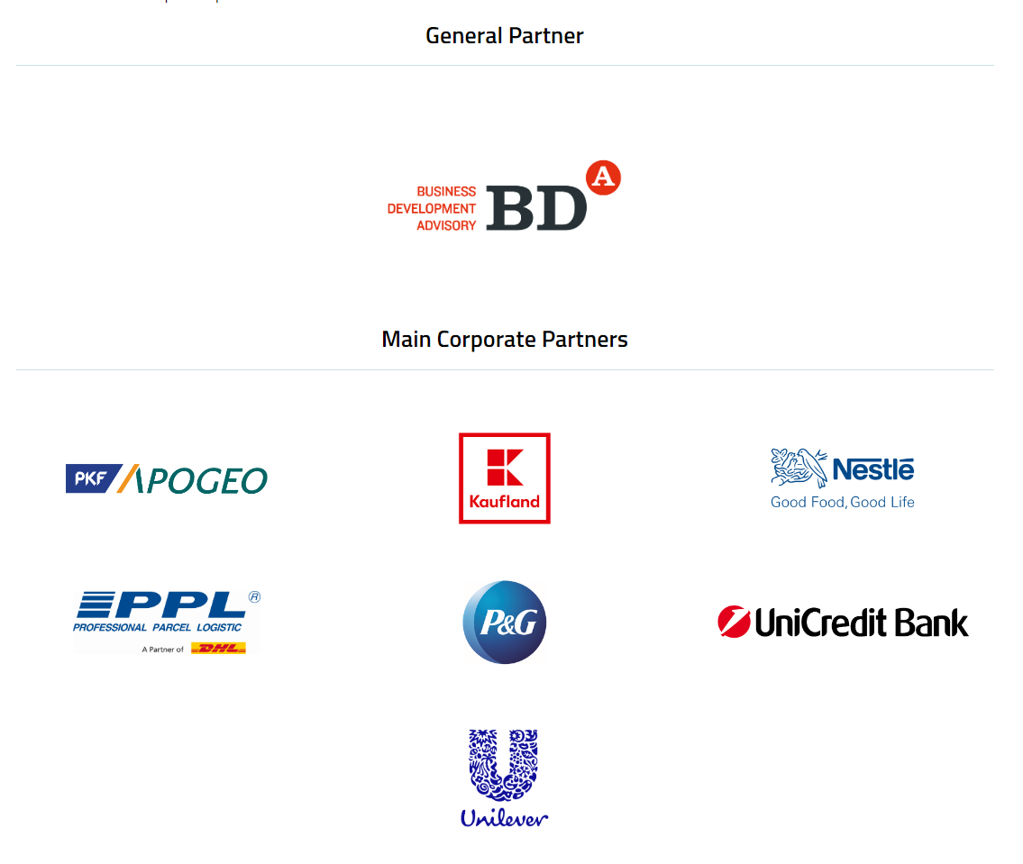

Connections with the Corporate World

Slide 8
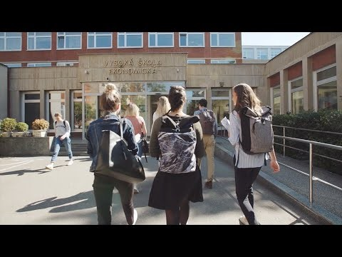
Faculty of Business Administration VŠE - the official promotional video

Slide 9
Apply to FBA
Name
Position
name.surname@vse.cz
https://fba.vse.cz/

Slide 10

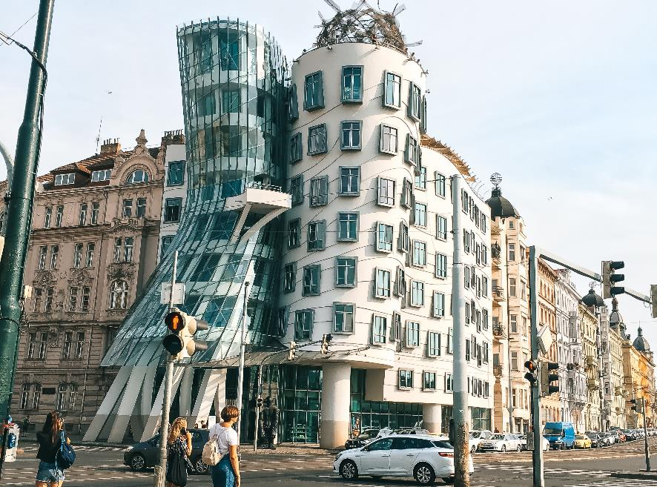
Study in Prague

Slide 11
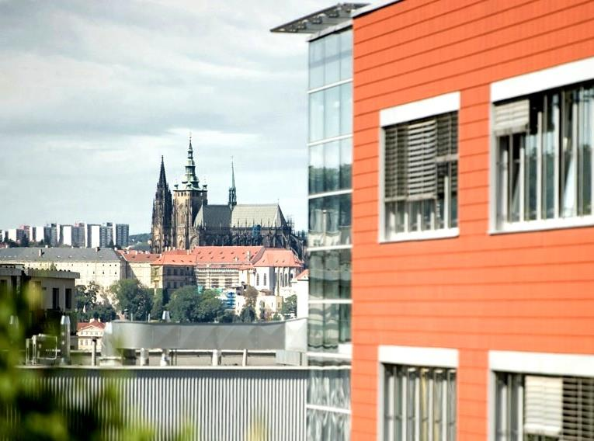
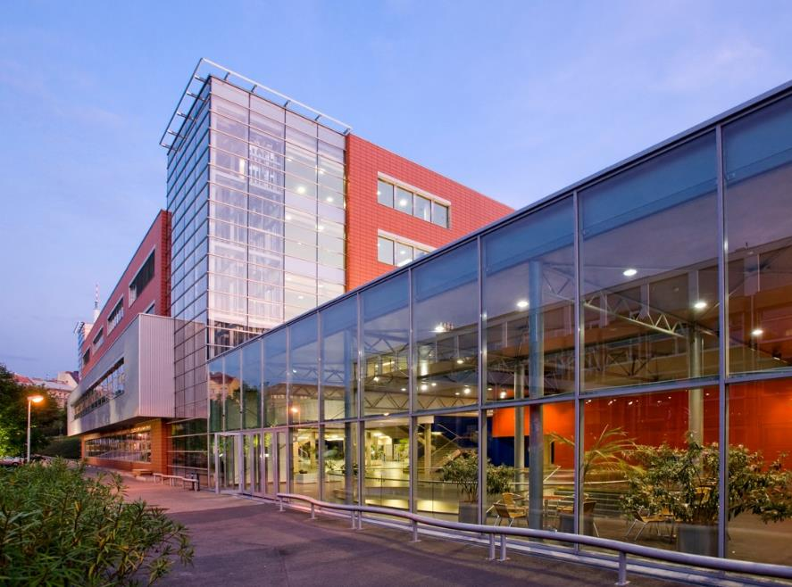
Campus VŠE Žižkov

Slide 12
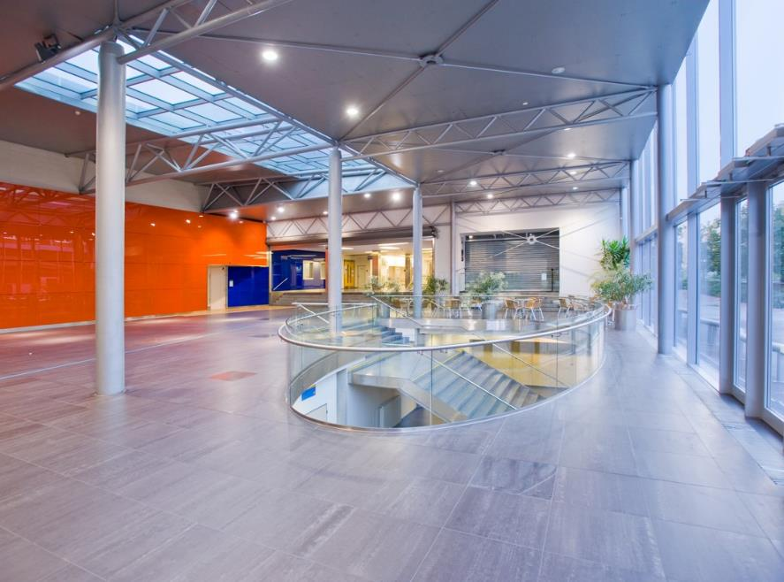
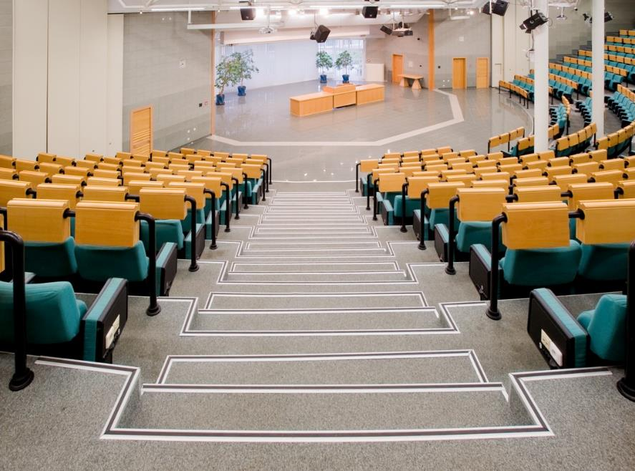
Campus VŠE Žižkov

Slide 13


Campus VŠE Žižkov - Library

